Slide 1
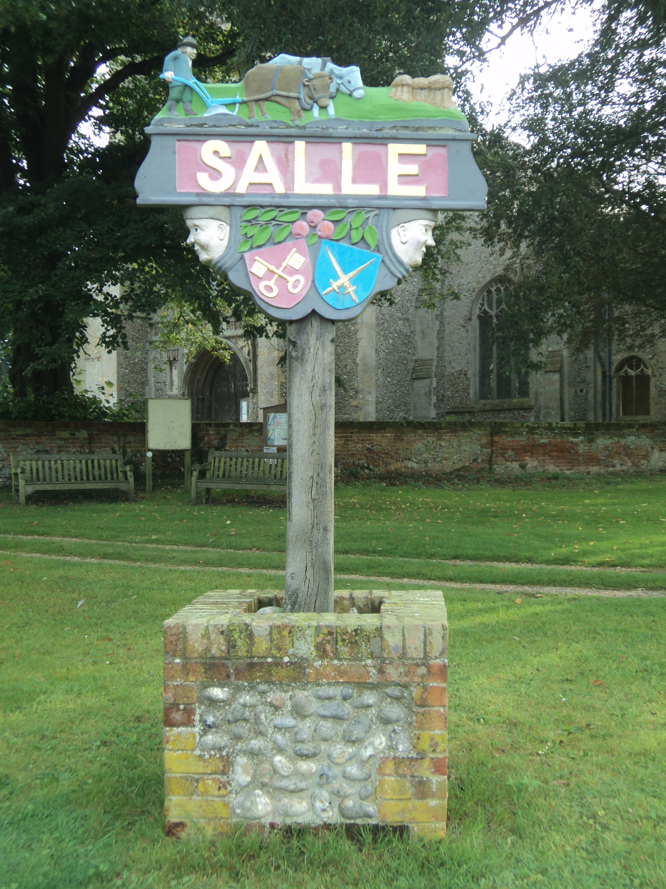
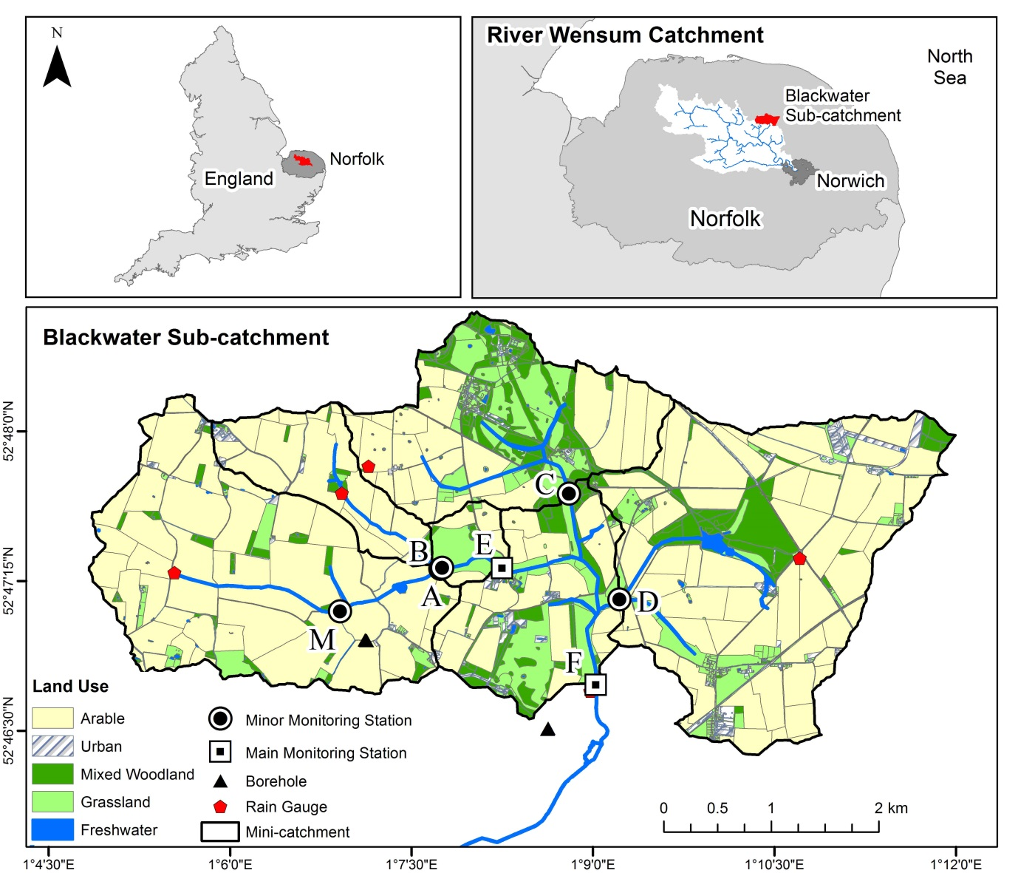
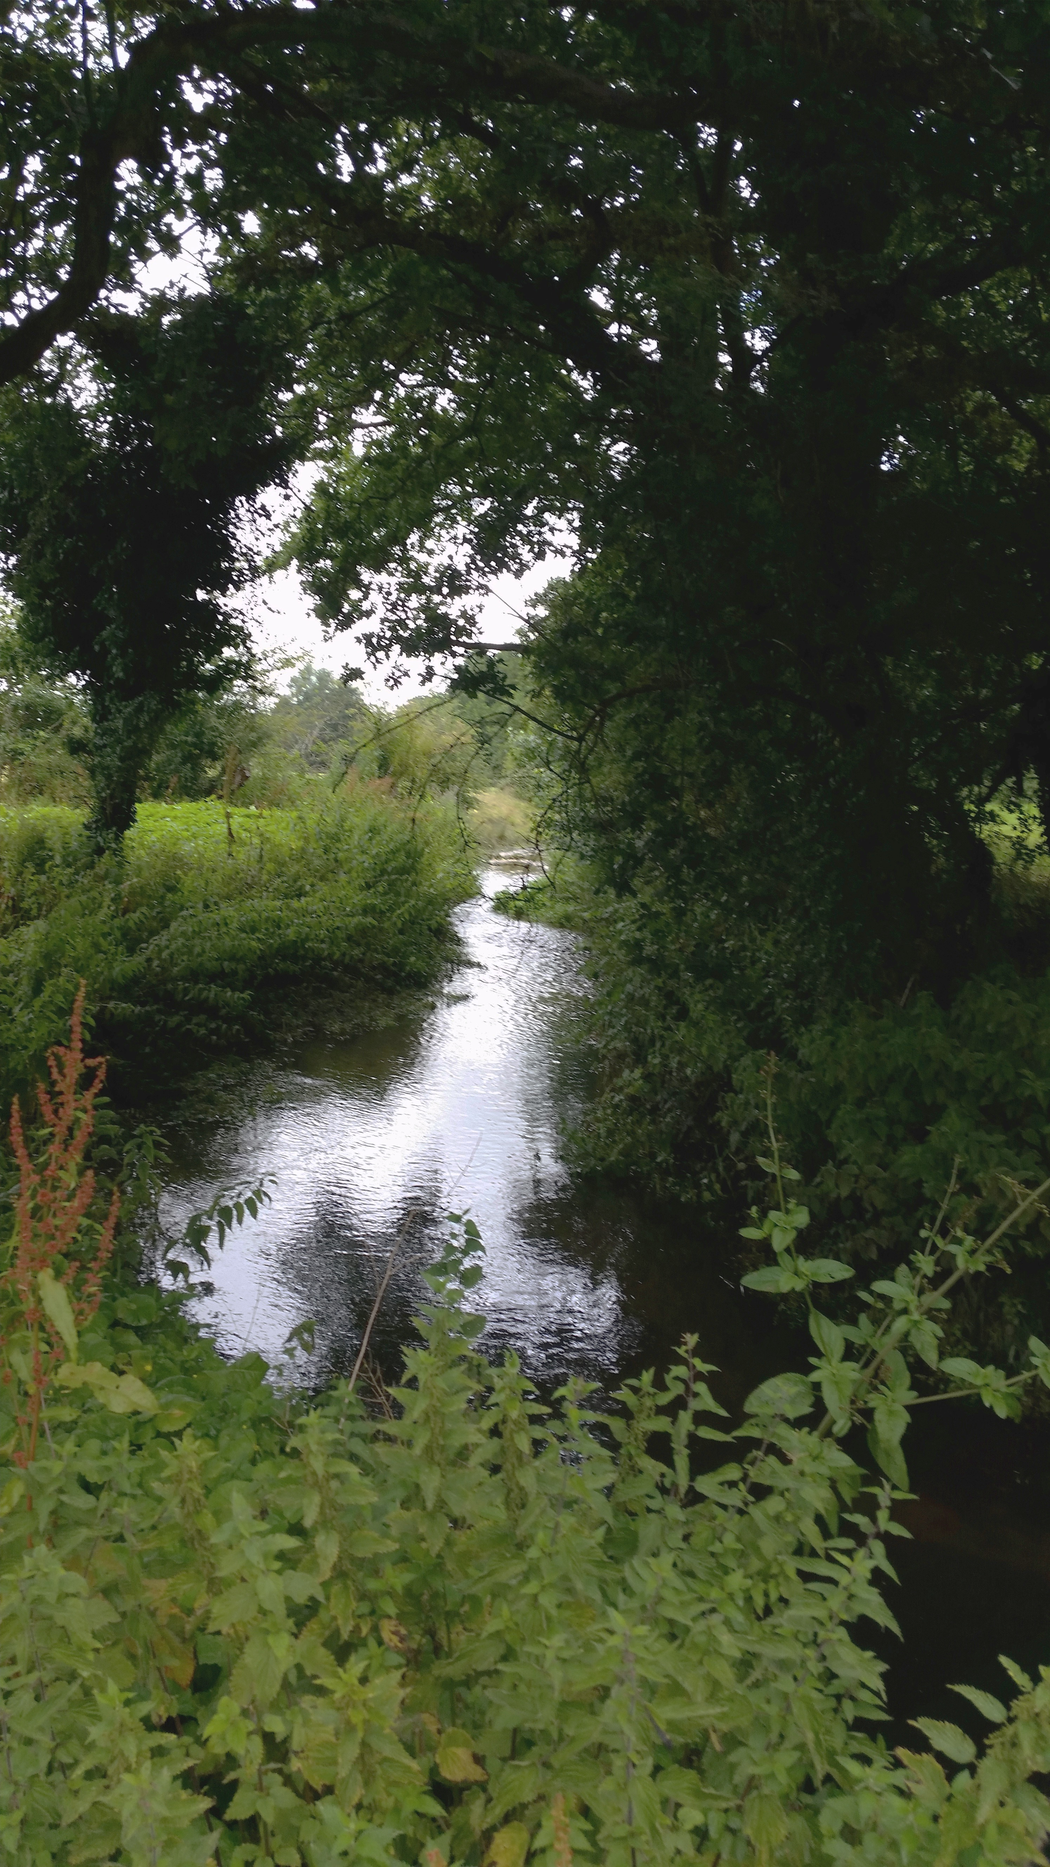
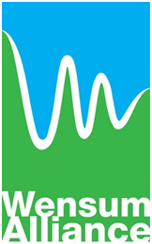
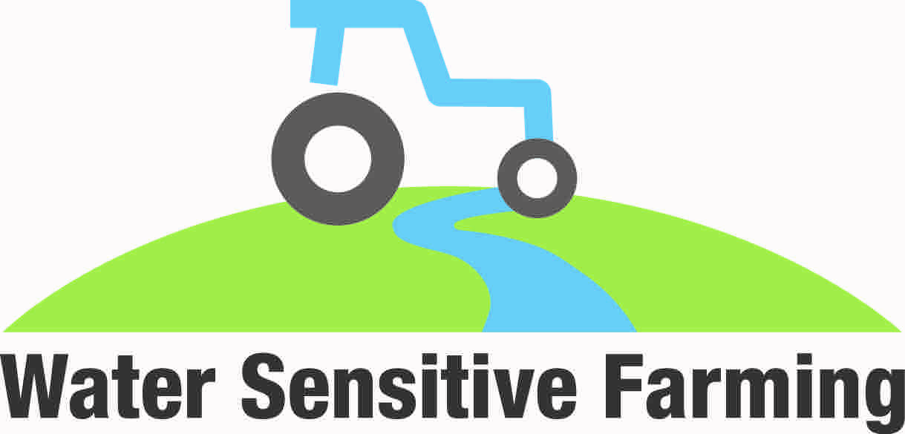
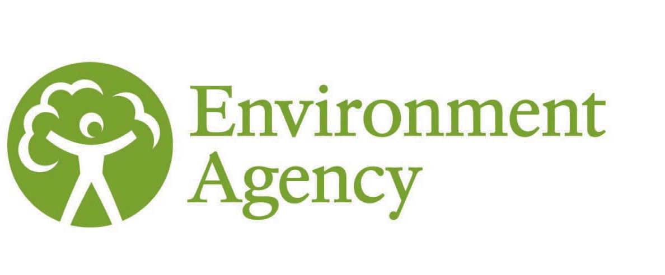
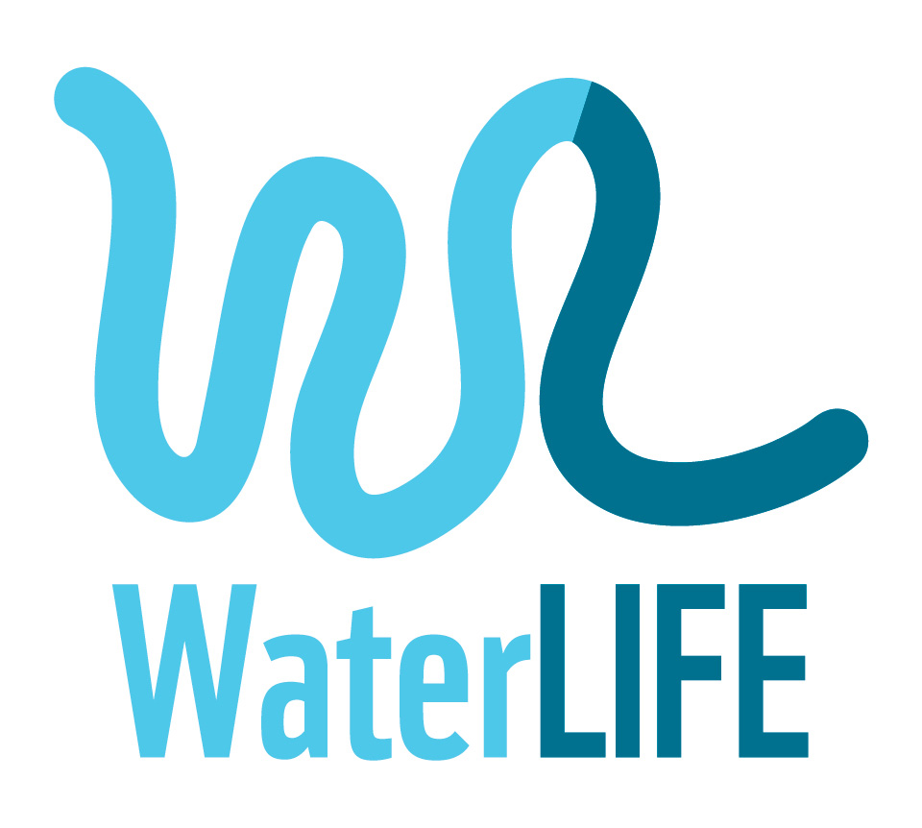
An Environmental and Socio-economic Case Study
Silt Traps on the River Wensum, Norfolk
Introduction
Run-off had been occurring from damaged road verges, eroded field entrances and agricultural topsoil from a sugar beet pad, at the Salle Estate located in the River Wensum catchment (Figure 1). The suspended sediment was running along a metalled road and flowing into the Blackwater Drain (Figure 2), which feeds the River Wensum and ultimately the Broads National Park.
The farmer had been aware of run-off issues occurring, and had already carried out important steps to trap the sediment and associated phosphorus and nitrogen on the farmland e.g. hedge improvement, rainwater harvesting and gateway relocation. However, since run-off had continued to occur, it was clear that intervention on a larger scale was required to intercept and reduce suspended sediment inputs to surface waters.
Salle Estate
Figure 1. River Wensum catchment and Salle Estate location.
Salle Estate, Norfolk
Size: 2,000 hectares
Crops: Combination of winter and spring-sown cereals, oilseed rape, sugar beet and peas/beans grown on a seven-year rotation
Catchment: Wensum
Sub-catchment: Blackwater
Topography: Some long, gentle slopes
Soil: Varies from light sandy loam to boulder clay
The Wensum catchment and Blackwater sub-catchment
The River Wensum is a lowland chalk-fed river in Norfolk, which has been designated as a Special Area of Conservation (SAC) and a Site of Special Scientific Interest (SSSI). The river provides a habitat for rare and diverse wildlife such as brook lamprey, brown trout, whorl snail and white-clawed crayfish. In total, the Wensum drains a catchment area of 593km³.
The organic carbon content of arable field soils in the Blackwater, a 20km² agricultural sub-catchment of the Wensum, is very low (median 1.4% soil organic carbon (SOC) content, Rawlins et al., 2013). Therefore, the stability of the soil structure is impaired, which can result in a high level of soil erosion and a susceptibility to weathering.
Additionally, the wider catchment has been designated as a Water Safeguard Zone (WSZ) due to the importance of underlying aquifers for supplying drinking water to local communities (Collins et al., 2013). As a result of these circumstances, reducing diffuse agricultural pollution is vital within this catchment.
Figure 2. Blackwater Drain.

Slide 2
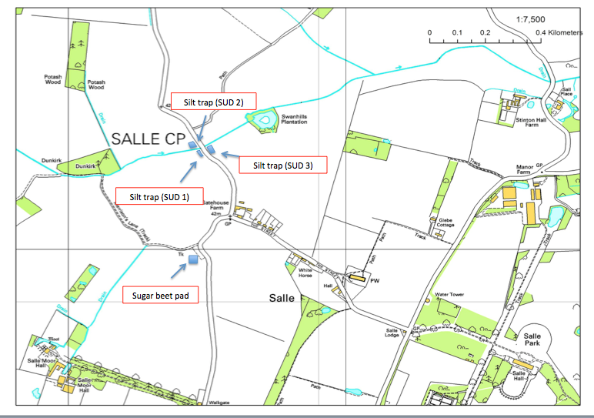
Figure 3. Salle silt traps, sugar beet pad and Blackwater Drain locations.
2. Assessment of the issues
An assessment of the site - using mapping (Scimap), visual observations during a walkover and farmer knowledge – was conducted to identify locations which posed the greatest risk i.e. high sediment supply, high soil moisture content, proximity to river channels and apparent connectivity to the rest of the catchment (roads or tramlines). Previous work in the area had already recorded that a metalled road was providing a significant pathway for agricultural (from a sugar beet pad) and roadside verge run-off to reach the River Wensum during rainfall events (Cooper et al., 2015).
3. Installation of silt traps
It was decided that three silt traps (Table 1) would be installed. These were constructed in Autumn 2016 on farmland belonging to the Salle Estate (Figure 3), situated alongside the metalled road in order to intercept this run-off transfer pathway (Figures 4 and 5).
The traps work by capturing and slowing down polluted run-off, which enables the sediment and suspended solids to settle out and clearer water to discharge to the Blackwater Drain. This is important as the solids can have pollutants such as nitrates and phosphates attached to them.
The traps require careful planning and maintenance in order to perform their optimum design function over a prolonged period of time. This involves removing the accumulated sediments and attached nutrients. This can then be returned to the field where it will benefit the farm (Figures 6 and 7).
Silt trap | National grid reference (NGR) | Area drained (acres) | Area drained (m²)
SUD 1 | TG105253 | 29.30 | 118,575.48
SUD 2 | TG104254 | 9.40 | 3.80
SUD 3 | TG104253 | 29.30 | 11.86
Table 1. Silt trap grid references and drainage areas.

Slide 3
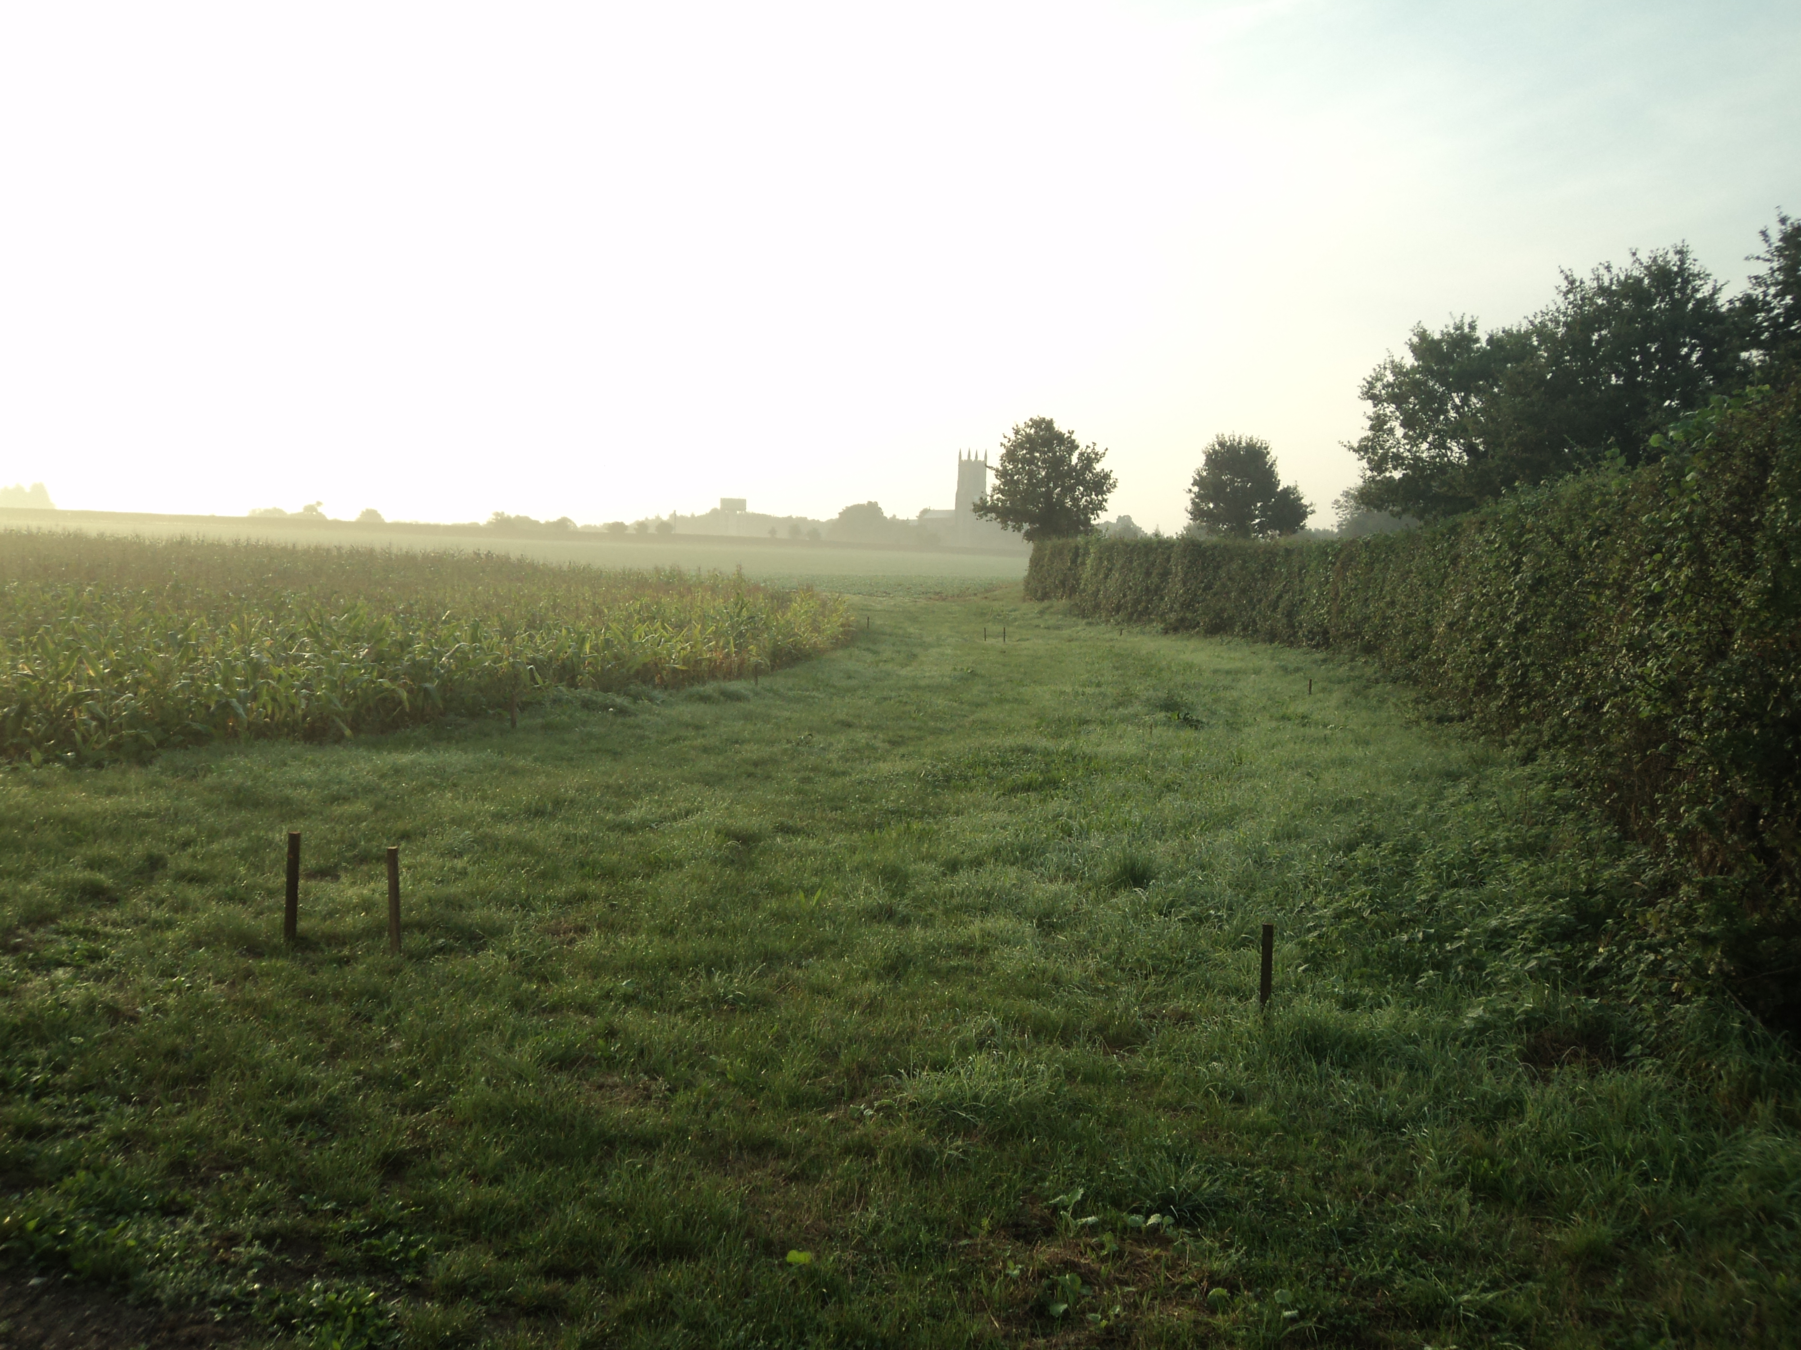
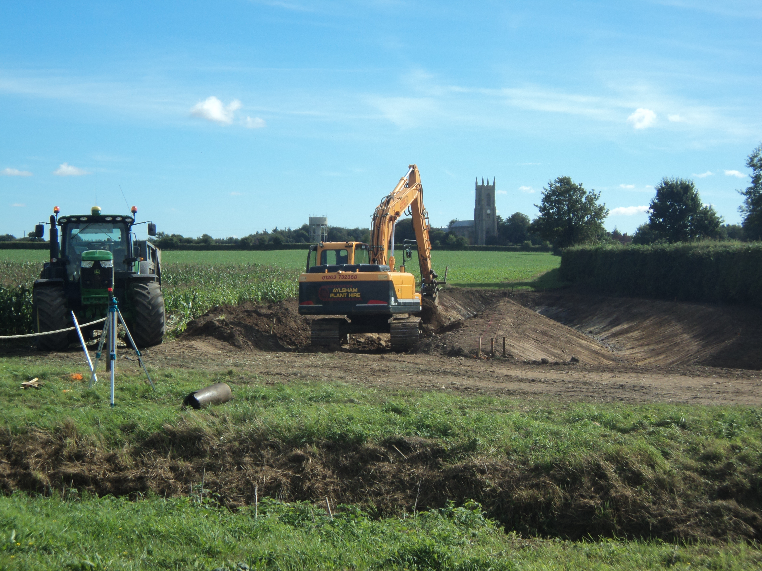
Figure 4. Marking out the site for silt trap 1 (SUD 1). Credit: Norfolk Rivers Internal Drainage Board.
Figure 5. Construction of silt trap 1 (SUD 1) at Salle.
Credit: Norfolk Rivers Internal Drainage Board.
4. Silt trap monitoring (to be updated when more results become available)
Throughout 2017, the University of East Anglia have been carrying out monitoring at the Salle Estate as part of the River Wensum Demonstration Test Catchments (DTC) project: a Defra, Environment Agency and Welsh Government Assembly initiative which aims to reduce diffuse agricultural water pollution through implementing on-farm mitigation measures.
Monitoring has been used to determine whether the silt traps have been effective at intercepting and retaining surface sediment before it reaches the river system. Thus far, the following outcomes have been ascertained:
4.1 Sediment source apportionment
Sediment fingerprinting is a process which can calculate the proportion of suspended sediment that originates from sub-surface sources (field drains and channel banks) and from surface sources (eroded arable topsoils and damaged road verges). This method was undertaken to determine whether the silt traps have effectively reduced the surface sediment entering the Blackwater Drain and was undertaken following rainfall events.
Comparisons between baseline data (collected between 2012 and 2014) and post-silt trap results have discovered that subsurface sediment proportions, particularly from channel banks, have been significantly higher. This indicates that the relative contributions from surface sediment sources have decreased following silt trap installation.
Additionally, the proportion of suspended sediment that originates from road verges was significantly lower post-silt trap installation and did not increase following rainfall events, which was consistently the case during baseline studies. This provides evidence that the silt traps are intercepting run-off that flows along the metalled road before it reaches the river system.
Although the proportion of topsoil contribution to sediment load was not found to differ pre- and post-silt trap installation, the actual volume of sediment contributed by topsoil was significantly lower than in 2012-2014. This demonstrates further that the silt traps are successfully trapping sediment run-off.

Slide 4
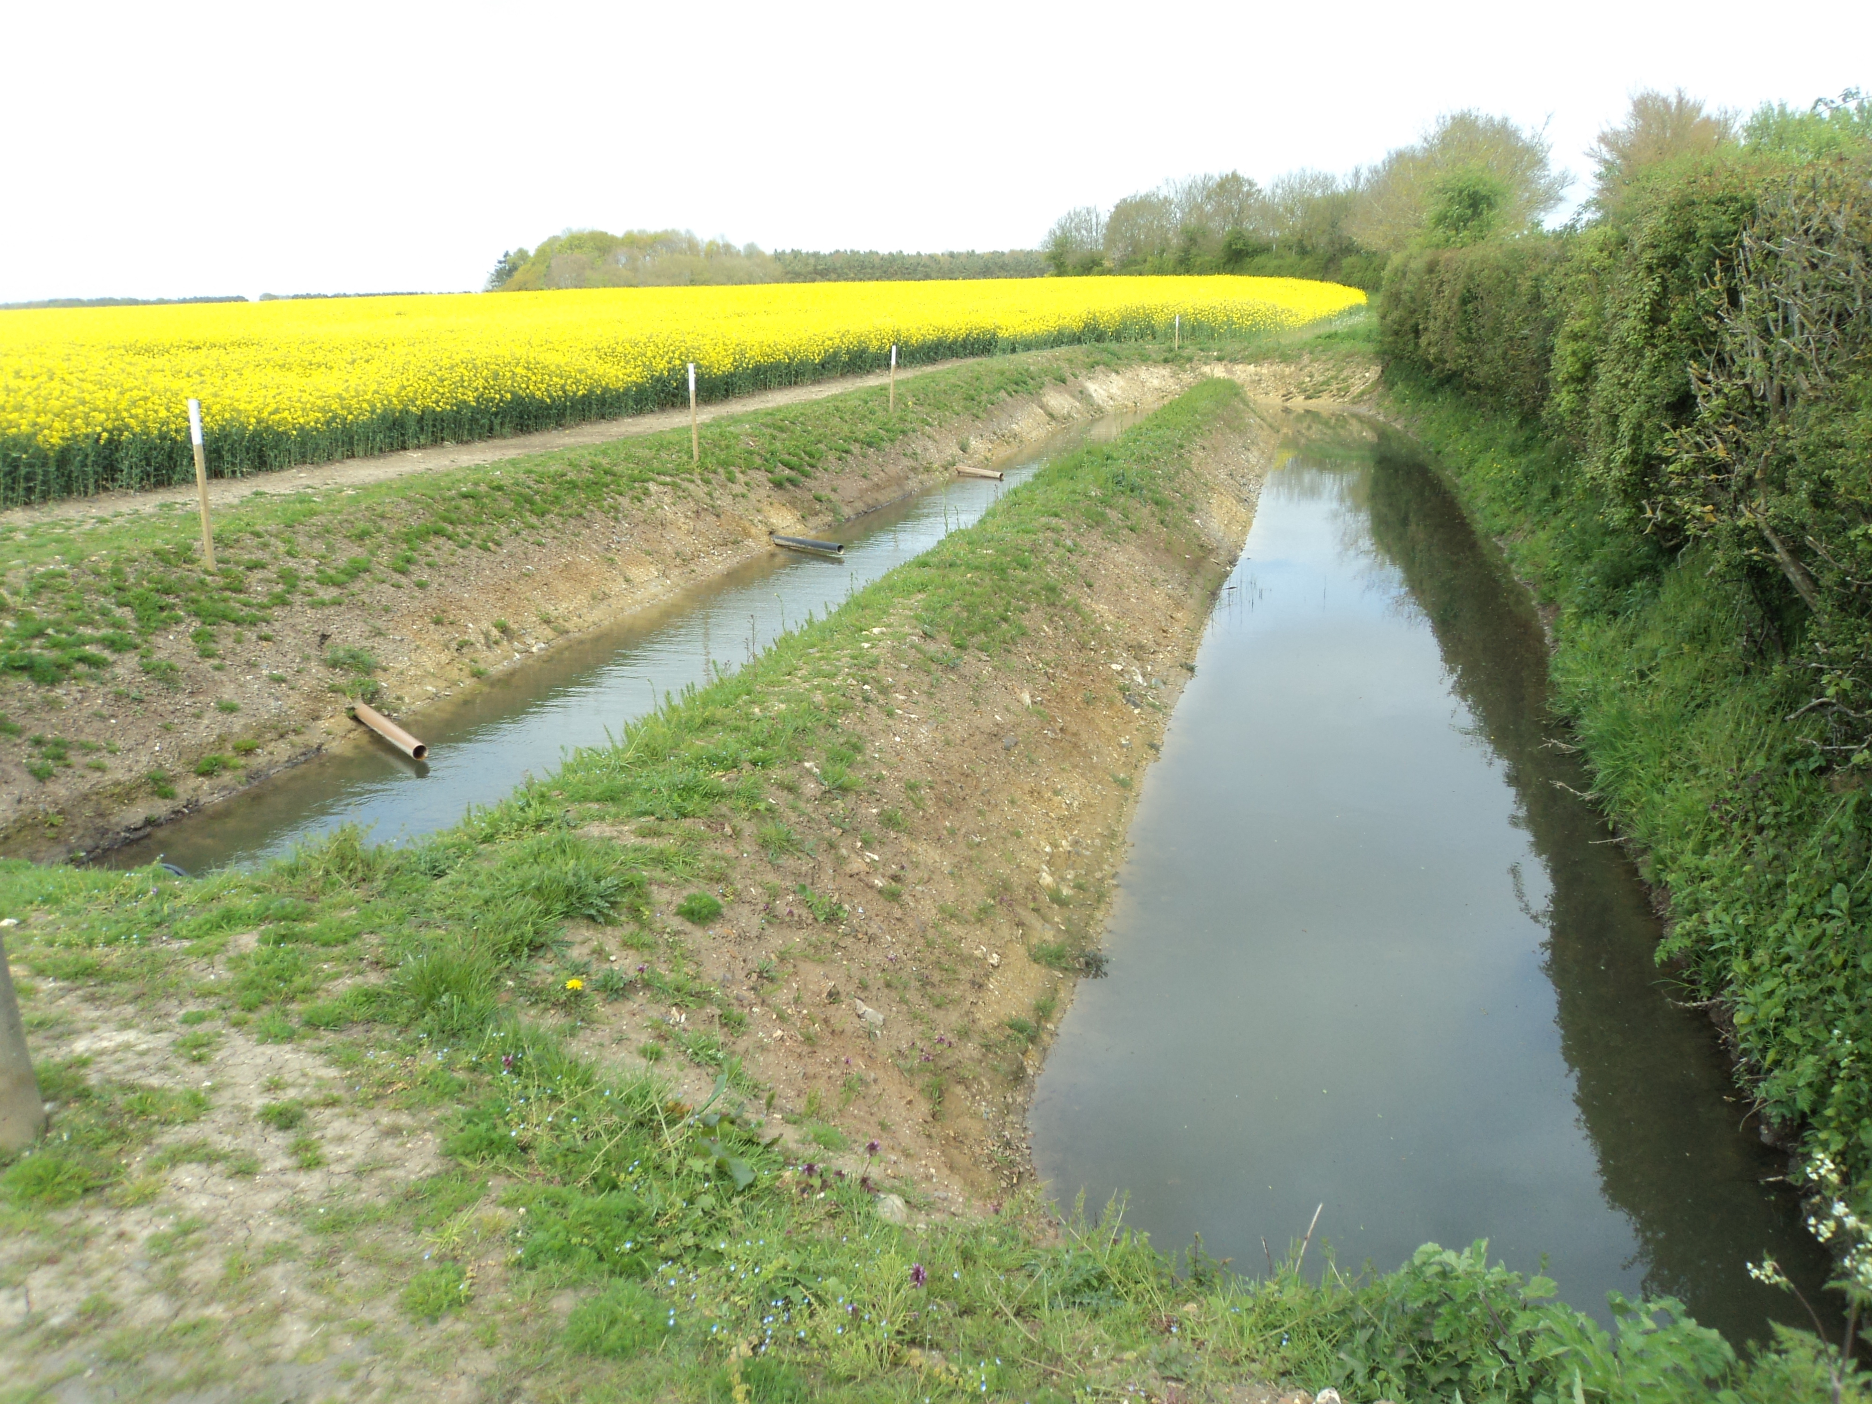
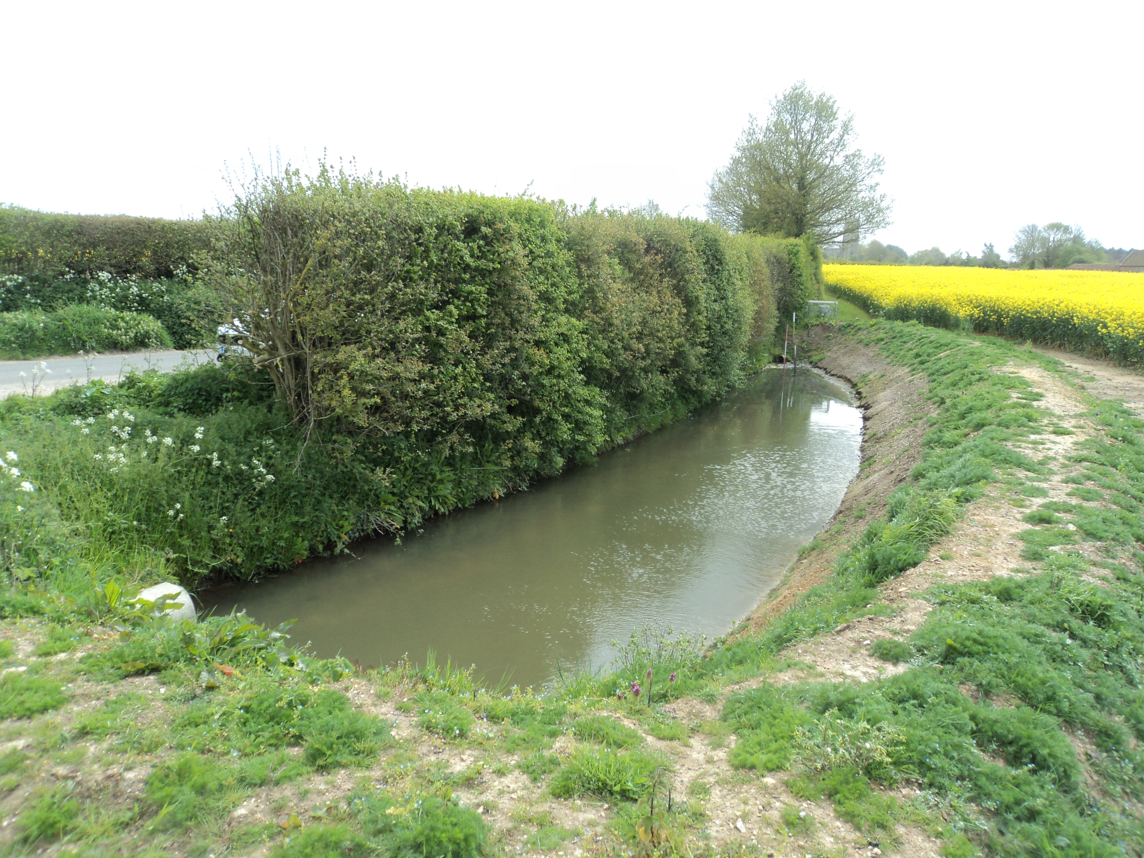
Figure 6. Silt trap (SUD 2) complete and draining water. Credit: Norfolk Rivers Internal Drainage Board.
Figure 7. Silt trap (SUD 3) complete and capturing run-off. Credit: Norfolk Rivers Internal Drainage Board.
4.2 In- stream sediment loads and turbidity
In-stream water samples were collected both upstream and downstream of the silt traps on a weekly basis between December 2016 and March 2017 to test for water quality (using 20+ parameters). High-resolution optical turbidity probes were also installed upstream and downstream of the site to measure turbidity at 30-minute intervals. The data obtained was compared with baseline river water quality data collected between 2012 and 2014.
The results revealed that in-stream sediment loads and turbidity were significantly lower than values reported pre-silt trap installation. This supports the hypothesis that the traps will reduce sediment quantities entering the river system. Moreover, visual observations of the traps confirmed that the traps were receiving significant levels of sediment-laden run-off during rainfall events.
These results conclude that the silt traps at Salle are an effective measure for reducing river sediment inputs from surface sources in an agricultural catchment.
4.3 Further expected results
Nitrate and phosphate retention
Recording of the amounts of nitrate, phosphate and organic matter retained within the traps will provide a figure for how many kilograms of N, P and C have been prevented from entering the river.
Drone survey
An aerial drone survey was conducted in November 2016 to calculate the dimensions of the traps so that their development can be monitored over time. It is hoped that another survey will be carried out in the late summer of 2017 for comparison, allowing an estimation of silt volumes accumulated since installation.

Slide 5
5. Environmental and Socio-economic Benefits
The silt traps at Salle will provide public economic benefits and will also deliver private financial savings for companies, farmers and landowners: a win-win outcome for all stakeholders. Where possible, the monitoring results will be quantified into £ savings in due course.
5.1 Water quality
A reduction in the nutrient inputs and sediment load reaching the River Wensum will improve the quality of water. As well as reducing the damaging effect that sediment and nutrient enrichment can have on the aquatic ecosystem (eutrophication and riverbed smothering), water treatment costs for drinking water consumption will also be lower.
5.2 Flood alleviation
The silt traps will prevent an increase in sediment accumulation in the river which, if allowed, could raise the level of the riverbed and increase water levels, posing a serious risk to the urban areas which the Wensum flows through. Moreover, the silt traps will release water at a slower rate, reducing the volume of water entering the watercourse during peak flood flow.
Both public and private savings could be achieved through a reduced flood risk: farmers/landowners will not be subjected to flood liability charges, and householders and local businesses will not be subjected to the costs associated with flood damage e.g. loss of business and repair.
5.3 Impacts on irrigation infrastructure
Increased sediment loading could have impacts on man-made infrastructure. For example, too much sediment can disrupt the normal functioning of irrigation pump house intakes and can also disrupt irrigation when excess sediment is deposited in the watercourse through blockages in pumps and distribution networks. Deposition in the river could lead to high costs for those reliant on these systems as a water supply and may even impact upon produce.
Furthermore, dredging may be required to remove surplus sediment, which is costly to operate and can be damaging for the aquatic habitat e.g. causes re-suspension of sediment and sediment associated contaminants and removes invertebrates and other organisms. By preventing excessive sediment loads entering the watercourse, the need for dredging can be reduced.
5.4 Recreational and cultural services
Thousands of tourists visit the River Wensum Catchment and the downstream Broads National Park each year to enjoy activities such as fishing, boating, water skiing and walking. This tourist ‘hotspot’ is very important for the local economy. Therefore, keeping the water and aquatic habitat clean will be important for the health and amenity of the area – not only in terms of visual amenity but also for fish reproduction and navigational purposes.
5.5 Farm business efficiency
Capturing nutrients and sediment before they leave the farm will reduce input costs for the farmer, in terms of fertiliser and pesticide purchase, as well as tractor fuel, spreading equipment and labour costs. This will ultimately benefit the farm business in the long-term. Additionally, increased yields could be achieved with the containment of valuable topsoil.

Slide 6
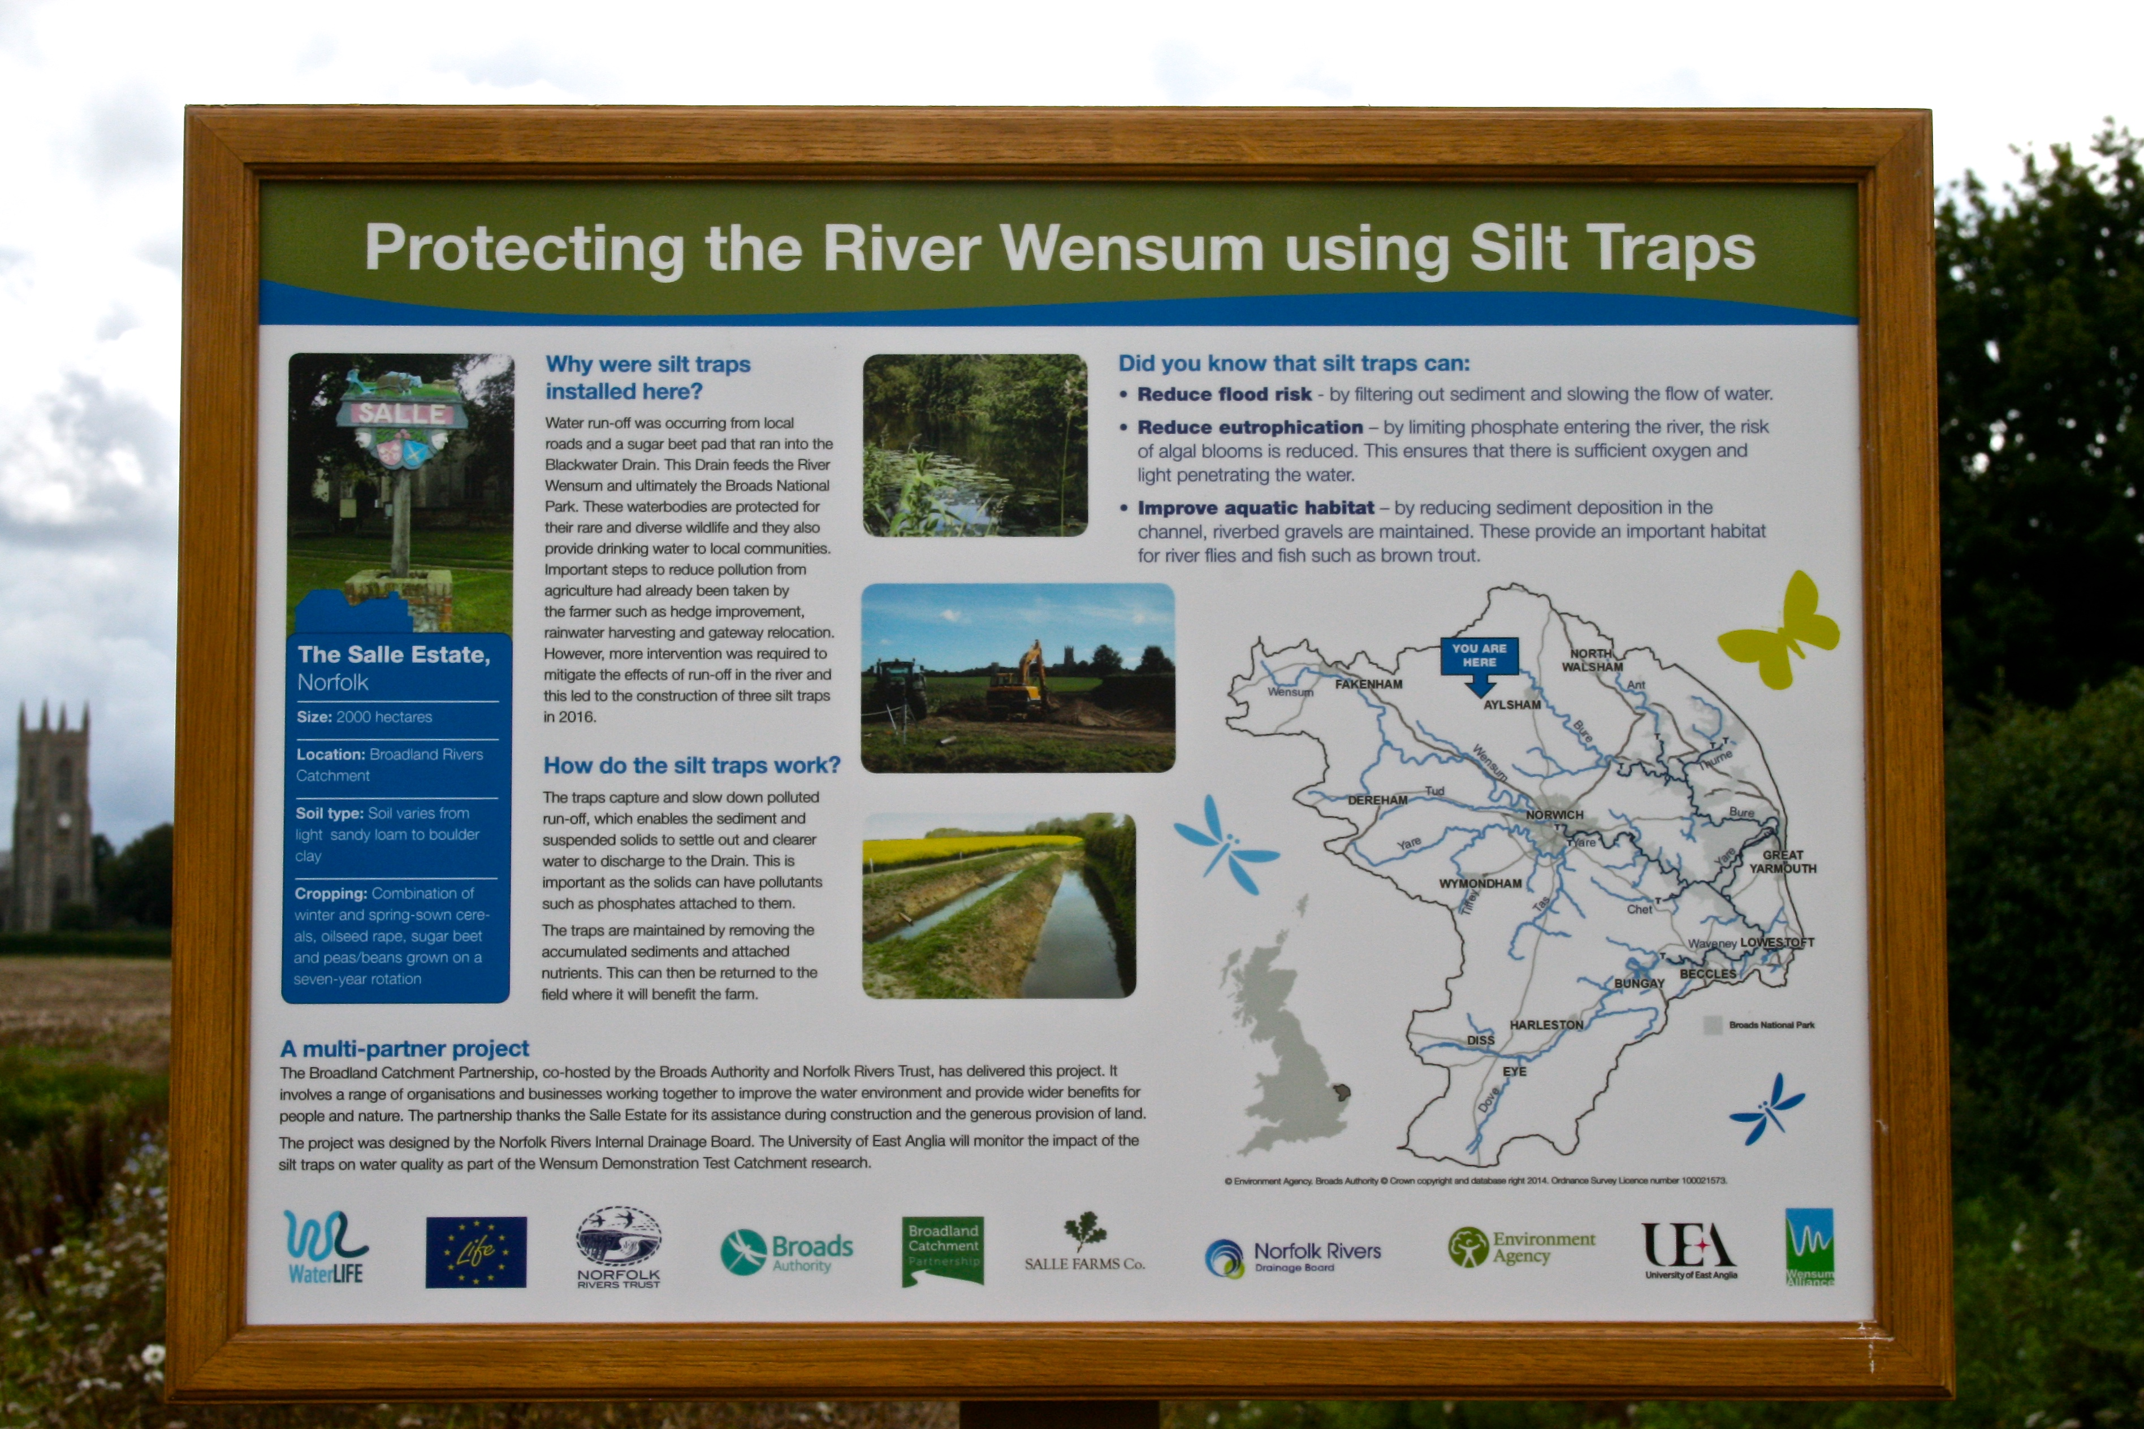
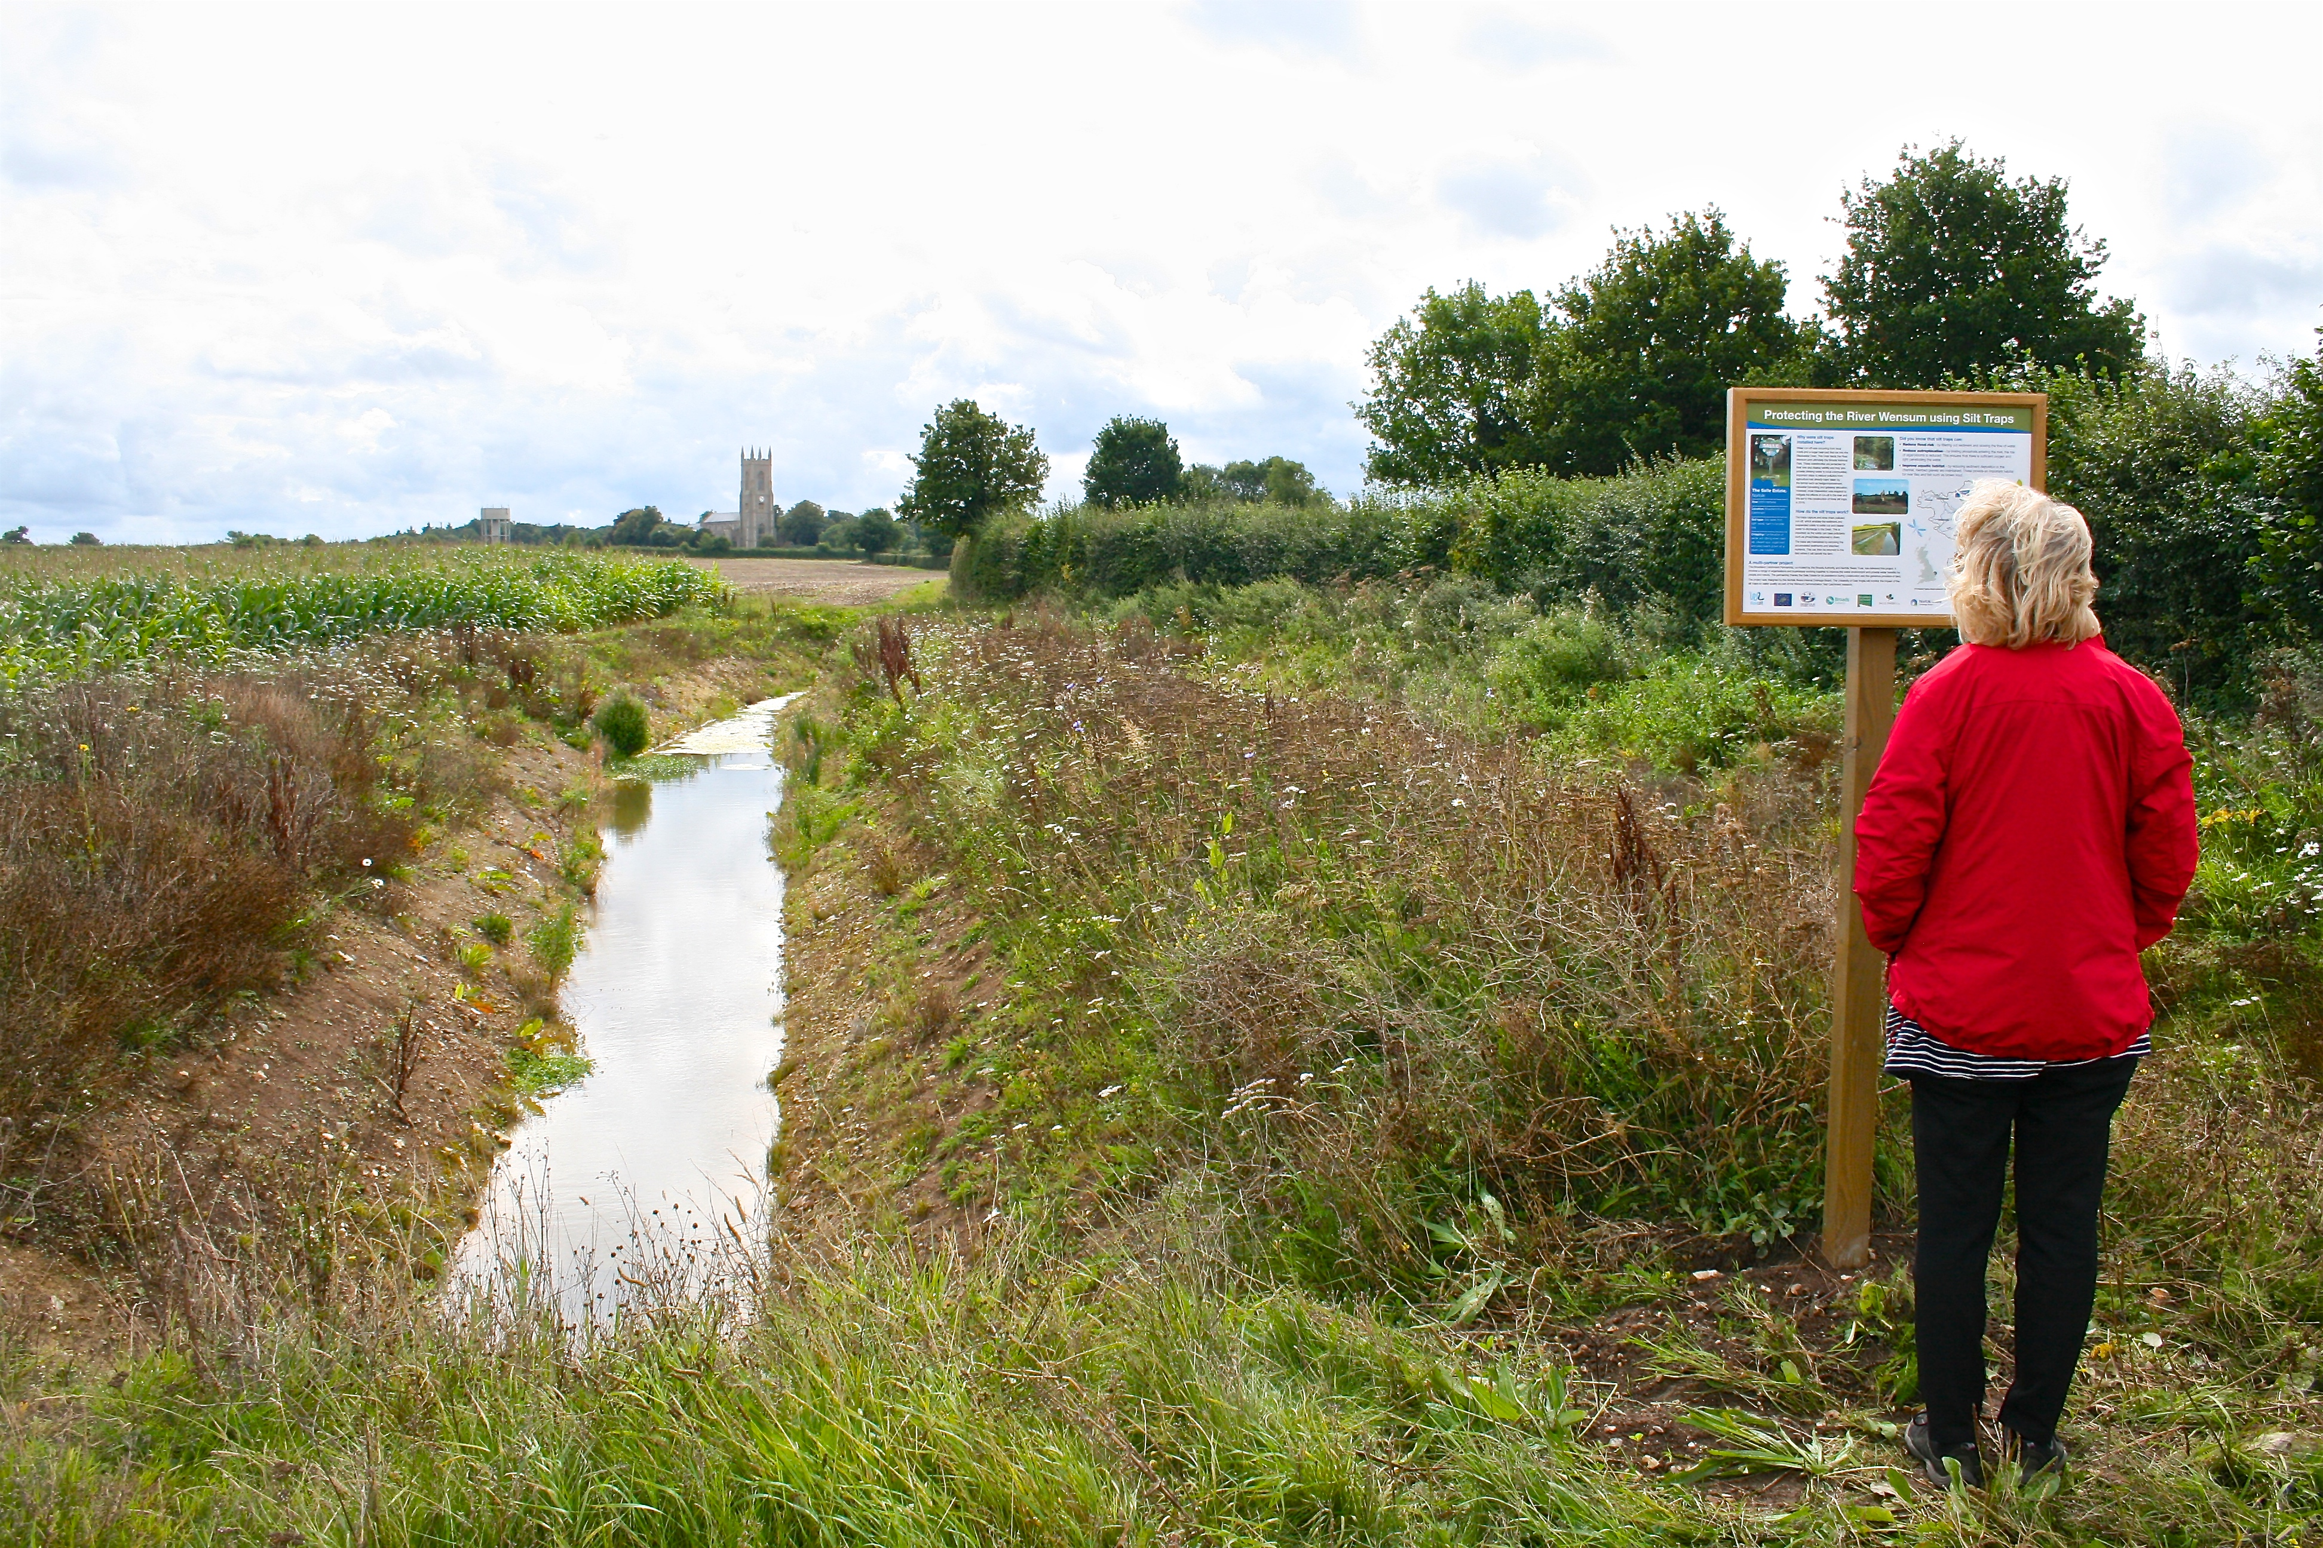
5.6 Educational
Events for farmers and landowners have been held at Salle. For example, as part of the ‘Innovative ways to improve soil, water and profits’ workshop, attendees were taken to see the silt traps. The site provides an excellent opportunity for holding knowledge-exchange events. These will be important for the sharing and dissemination of novel and cost-effective water sensitive farming measures. Moreover, if these measures were to be implemented across the farming landscape, financial savings could be multiplied, both for farmers and the public.
The silt traps are in a visible location, which will be seen by the public (Figures 8 and 9). Therefore, they could have the potential to inform the public about water sensitive farming and could also improve public perceptions of the farmer and farming industry.
Figure 8. An interpretation board that has been installed at the Salle Estate.
Figure 9. The interpretation board has been installed to explain the purpose of the silt traps to the public.
A collaborative, multi-partner project
The silt traps were designed by the Norfolk Rivers Internal Drainage Board and constructed by Aylsham Plant Hire. They were supported by the Water Sensitive Farming project 2016-2018 (with funding from Coca-Cola, distributed through the EC LIFE+ WaterLIFE project); the Environment Agency under the Norfolk Rural Sustainable Drainage System Project 2016/17; and the Salle Estate. The University of East Anglia is monitoring the effect of the traps on water quality as part of the Defra Demonstration Test Catchments programme.
The project was facilitated by the Broadland Catchment Partnership that is co-hosted by the Broads Authority and Norfolk Rivers Trust. The Partnership involves a range of organisations and businesses working together to improve the water environment and provide wider benefits for people and nature. The Partnership thanks the Salle Estate for its assistance during construction and the generous provision of land.
References
Cooper, R. J., Krueger, T., Hiscock, K. M., and Rawlins, B. G. (2015). High-temporal resolution fluvial sediment source fingerprinting with uncertainty: a Bayesian approach. Earth Surface Processes and Landforms, 40, 78–92.
Collins, A. L., Zhang, Y. S., Hickinbotham, R., Bailey, G., Darlington, S., Grenfell, S. E., Evans, R., and Blackwell, M., (2013). Contemporary fine-grained bed sediment sources across the River Wensum Demonstration Test Catchment, UK. Hydrological Processes, 27, 857–884.
Rawlins, B. G., Wragg, J., & Lark, R. M. (2013). Application of a novel method for soil aggregate stability measurement by laser granulometry with sonication. European Journal of Soil Science, 64, 92-103.

